Slide 1


Chapter III - 2025
COPYRIGHT (C) 2025, ECLIPSE FOUNDATION

Slide 2
PITCHING SESSION Team TIDE
COPYRIGHT (C) 2025, ECLIPSE FOUNDATION

Slide 3

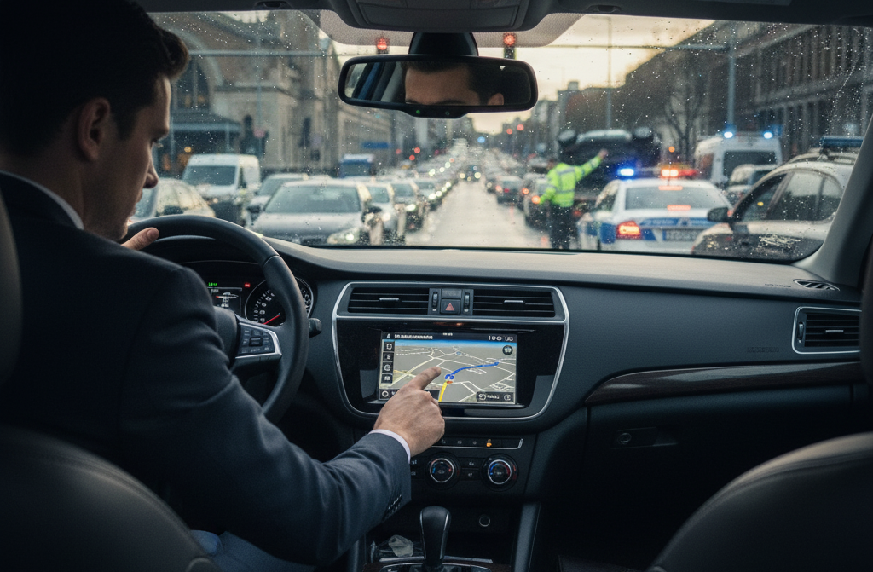
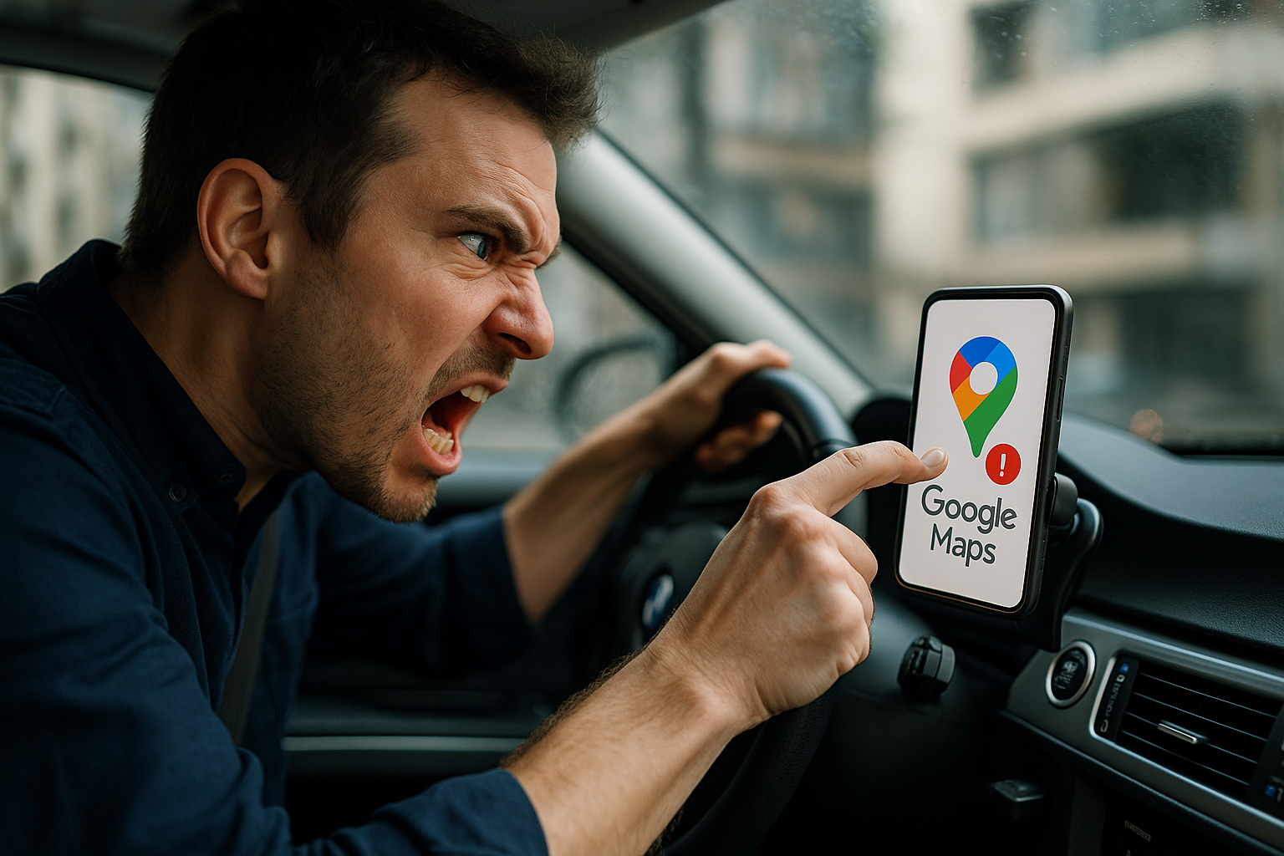
Initial problem
If you ever used Google Maps or Waze you all know that feeling too well…
Manually confirming if an incident, like a car crash, is still there is annoying, distracting, and potentially dangerous.
Half the time, the event isn’t even there anymore!

Slide 4


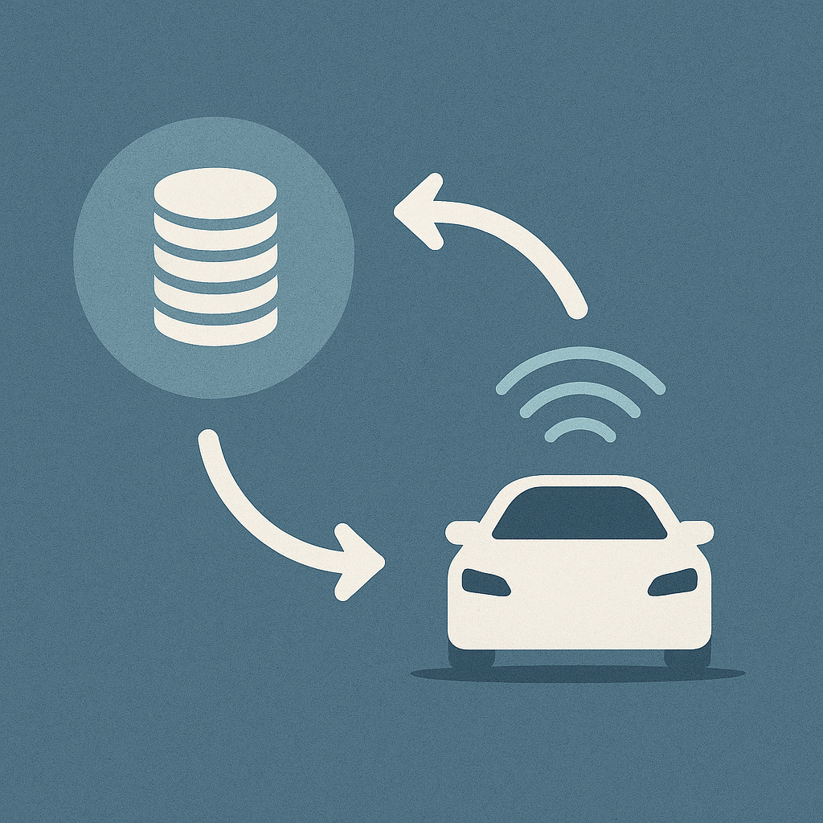
Our solution
What if your car could do this automatically for you?
Our solution is real-time, AI incident monitoring powered by distributed cloud intelligence
It fosters the power of autonomous driving sensorset to detect incidents
Enabled by the clouds power of distributed services, it can provide incident information anytime, anywhere
It is able to provide real-time insight to drivers, navigation systems, and public authorities about events occurring

Slide 5




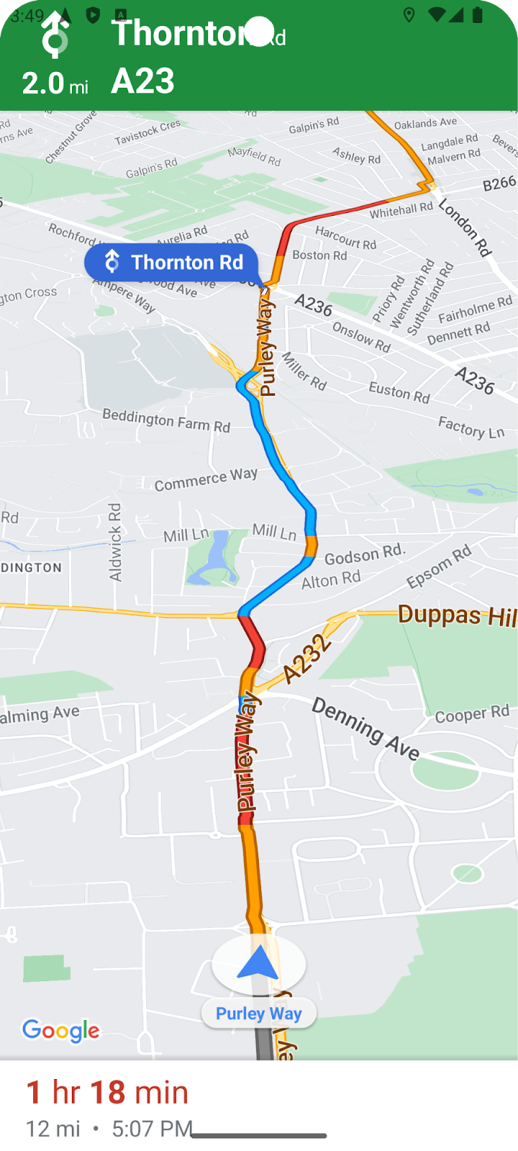



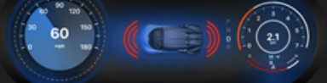
Technical implementation
Server
Integration
Incident classification
Vehicle
Mobile App
Sensorset
Driver Display
Ego-Location
Incident notification
Incident notification
Semantic Segmentation

Slide 6
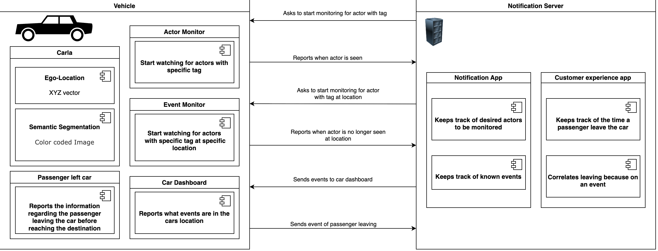
Team and Structure
Server
Integration
Integration
Axel Lichtner
Kenny Mead
Vehicle
Mobile App
Sensorset
Driver Display
Donghyun Kim
Donghyun Kim
Kenny Mead
Leonardo Ferrari

Slide 7
The Market & The Competition
Market Potential
Growing market for ADAS systems, autonomous driving and connected vehicles
new demand for hazard-detection data services due to Increasing urban mobility projects and smart city initiatives
Competitors
Waze / Google Maps
Depend on crowdsourced reports from users
Information may be delayed, inconsistent, or biased
Other ADAS OEM solutions
closed, proprietary ecosystems
Data not shared cross-platform or with city authorities
Our Differentiation
Cross-platform compatibility → works with any ADAS-equipped vehicle
Automated, sensor-based detection → no manual input, faster & more reliable
Open protocols → interoperability & scalability
City-level analytics dashboards → valuable insights for urban planning & fleet management

Slide 8
Business Model * Plan & Funds
Revenue Streams
Licensing to Automakers
Subscriptions for Fleet Operators
Data Dashboards for Cities
Licensing to map and navigation system providers

Slide 9
Contact
Integration Engineer & DevOps – Kenny Mead
Function Development Engineer – Axel Lichtner

Slide 10
Thank You slide
Thank your audience and encourage them to get in touch afterwards.
COPYRIGHT (C) 2025, ECLIPSE FOUNDATION

Slide 11
Technical implementation
In case we are in the finalists make nicer!!!

